Slide 1
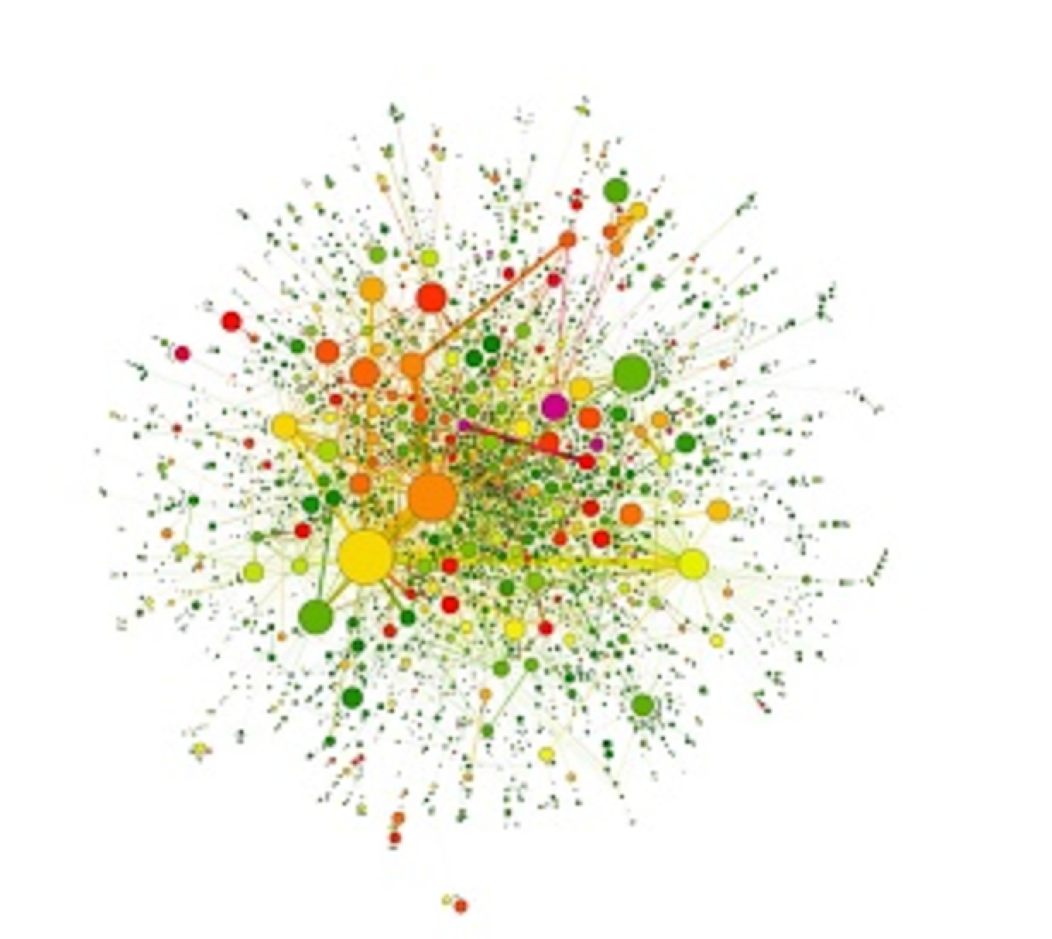
P(egs) bioinformatics for Postgrads
Postgraduate Evolution and Genomic Science Lecture series.

Slide 2
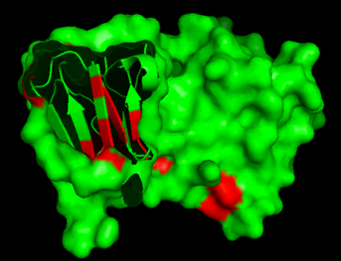
Protein Structure Analysis
Shalaw Sallah, 3rd year PhD Student
(shalaw.sallah@manchester.ac.uk)
Genomic Medicine
(Graeme Black & Simon Lovell)
Studying effects of variants on protein stability through homologous 3D structures
Protein variant interpretation
Protein structure analysis
Other applications include site-directed mutagenesis, protein-ligand binding & interaction sites, etc

Slide 3
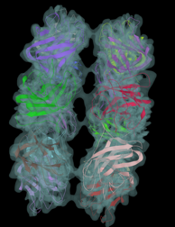
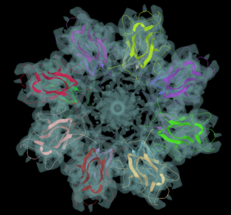
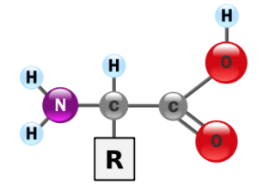
Protein Structure
A sequence of amino acids (Primary Structure)
A hydrogen atom (H)
A Carboxyl group (-COOH)
An Amino group (-NH2)
A "variable" group
One or more of these polypeptide chains fold to form a protein (a monomer or a multimer)

Slide 4
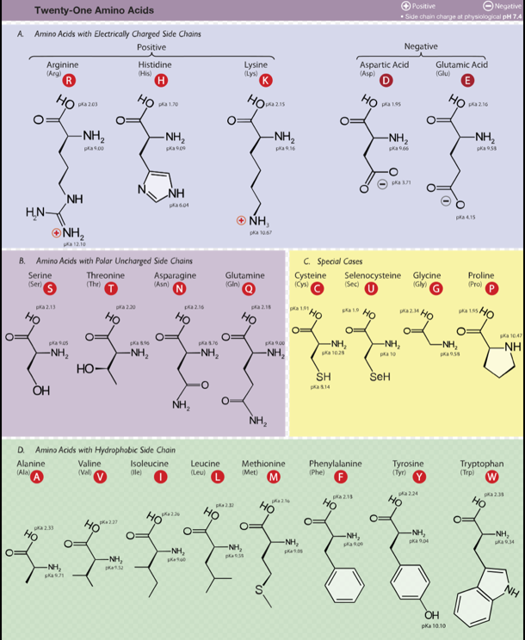
All 20 Amino acids
Different amino acids have different properties
“Classed” roughly into groups
Wikipedia

Slide 5
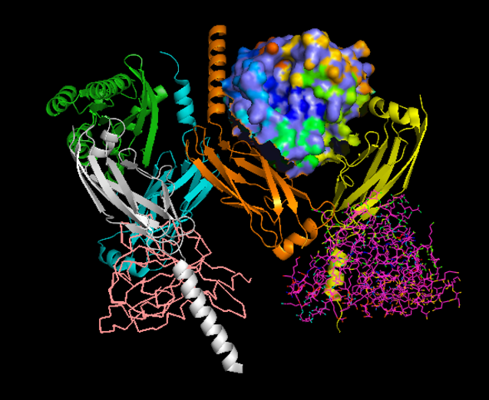
Stretches of amino acids have distinct conformations (Secondary Structure)
Part of OCRL (example):
Alpha Helix
Beta Sheets
Turns & Loops
Different representations may be used

Slide 6
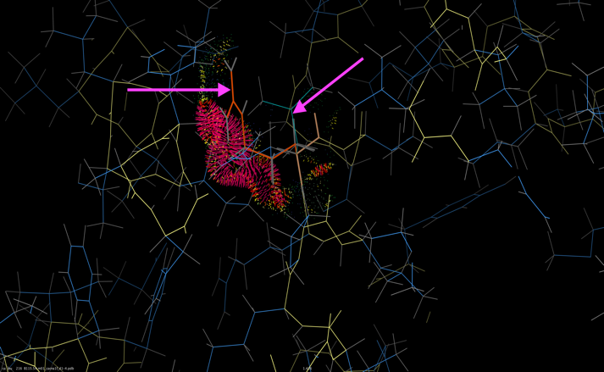
Protein Structure Analysis
A point mutation in a protein coding region of DNA ➔ amino acid change
Studying effects of changes on protein stability through 3D structures:
Amino acid properties
Hydrophobic ➔ hydrophilic
Loss of ionic bonds
Molecular goodness-of-fit
(Backbone strain and void formation)
Interaction site?
p.(Leu216Arg)

Slide 7
Topics to discuss
Finding the Protein sequence
Get its structure, if available
No structure: modelling
Analyze point mutation & its effect on protein structure/function

Slide 8
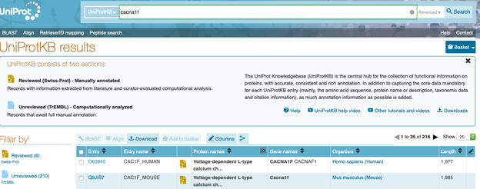
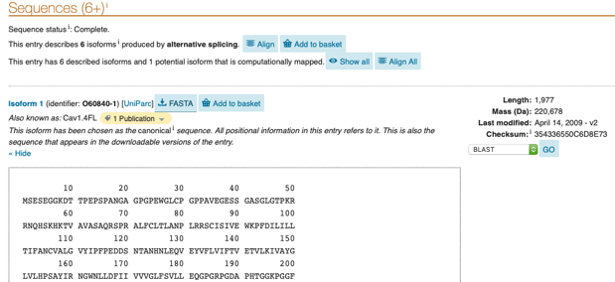
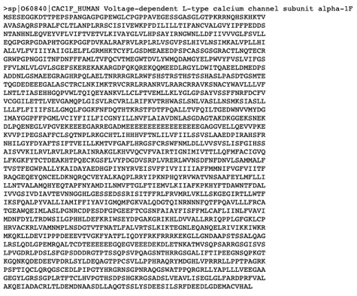
1) Get Protein Sequence from UniProt using the gene name
Notes:
Select the Human sequence from the results returned. Copy the FASTA format (at the end)

Slide 9
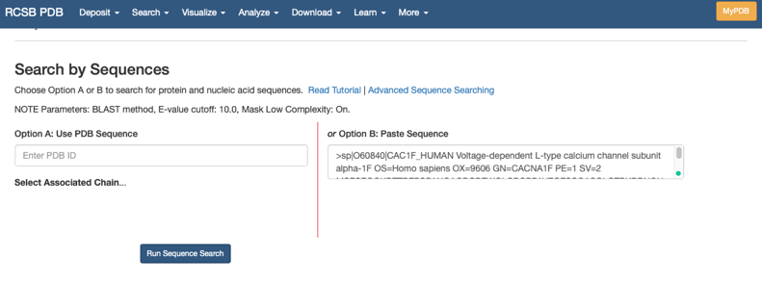
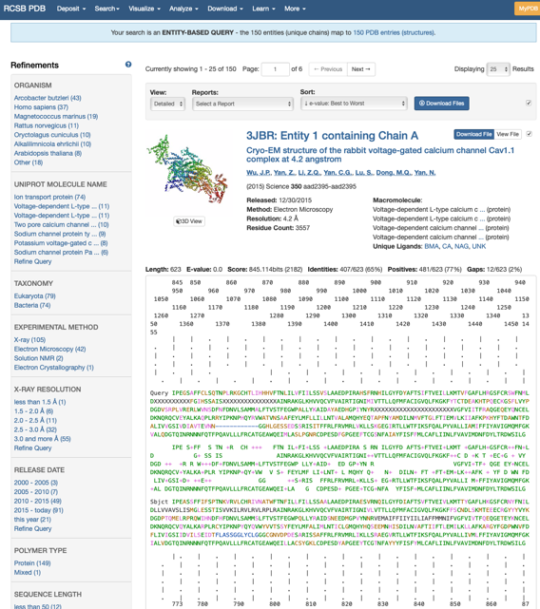
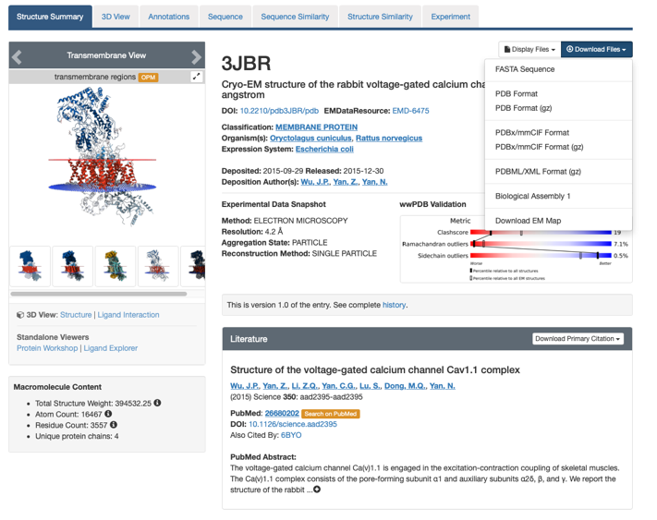
2) Protein structure from PDB
Notes:
Paste the sequence from UnoProt here

Slide 10
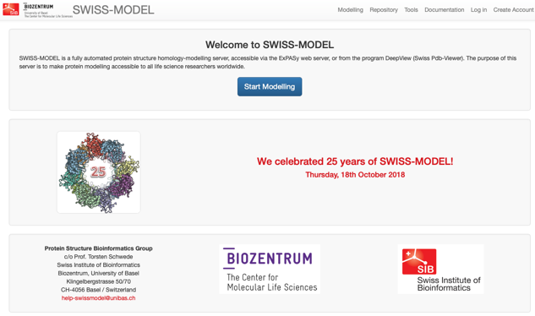
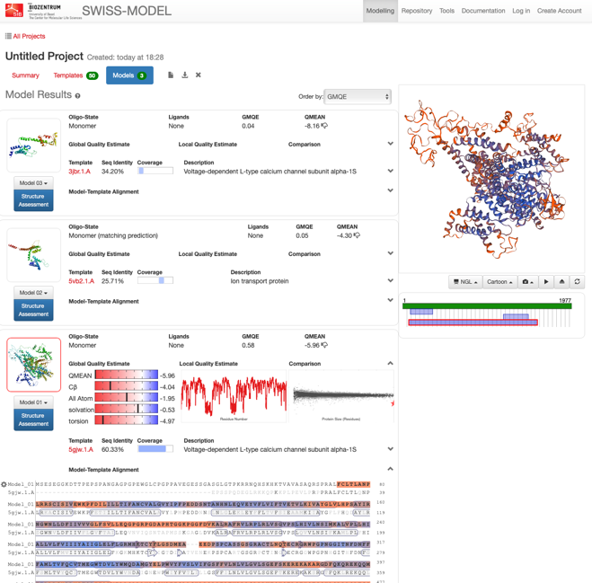
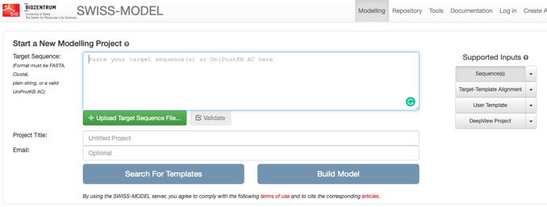
2) Homology modelling (using SWISS-MODEL)
Notes:
Download the pdb file from the “Model” created

Slide 11
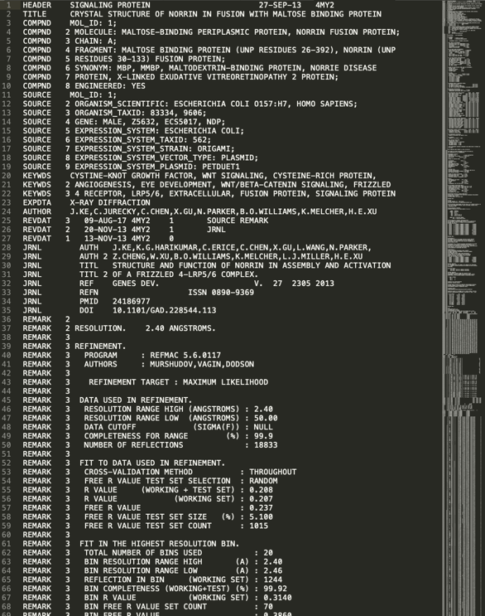
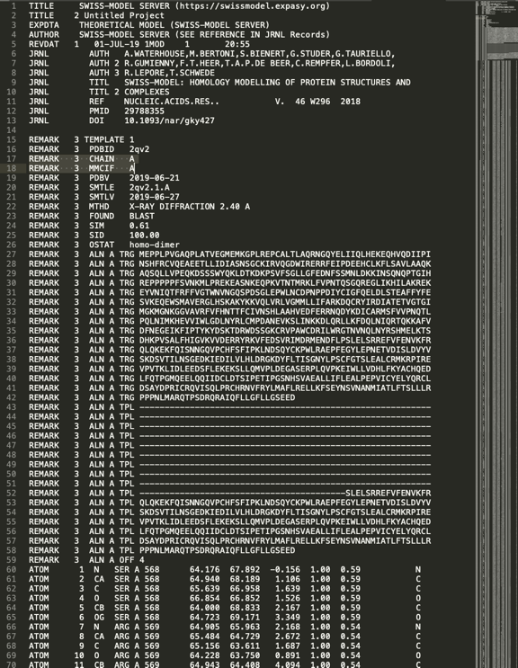
A pdb format file
Pdb file of a solved structure
Pdb file of a model
Notes:
What a pdb file looks like

Slide 12
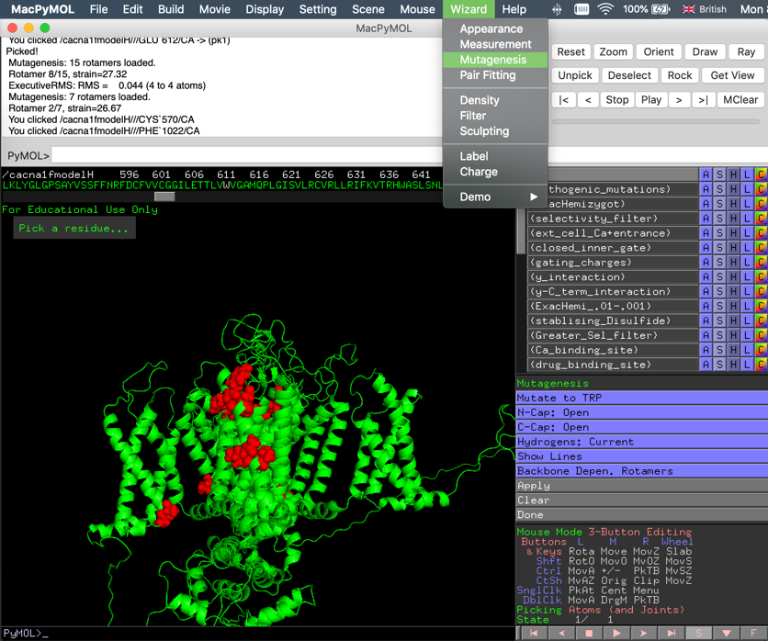
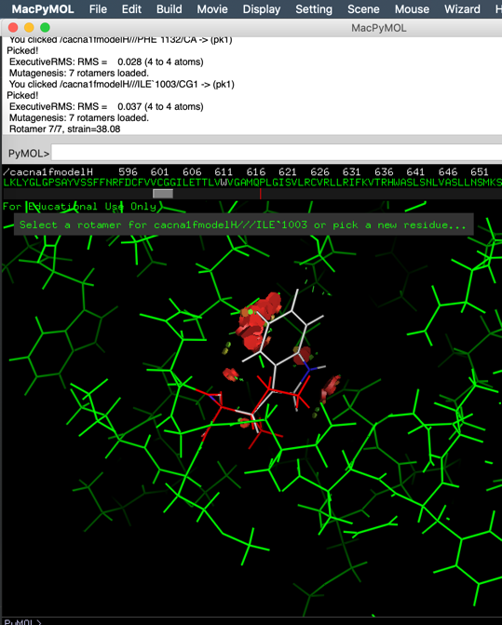
3) Protein Structure Analysis
Open pdb format file Using PyMol
Notes:
The red spheres on the left screenshot are highlighted amino acids for visualization purposes.
The red blubs on the right screenshot represents clashes between atoms of a larger amino acid (in white replacing the original amino acid in red), as a result of a mutation, and the atoms of the surrounding amino acids. This could be interpreted as a mutation that could potentially affect the folding of the protein and or make it unstable

Slide 13
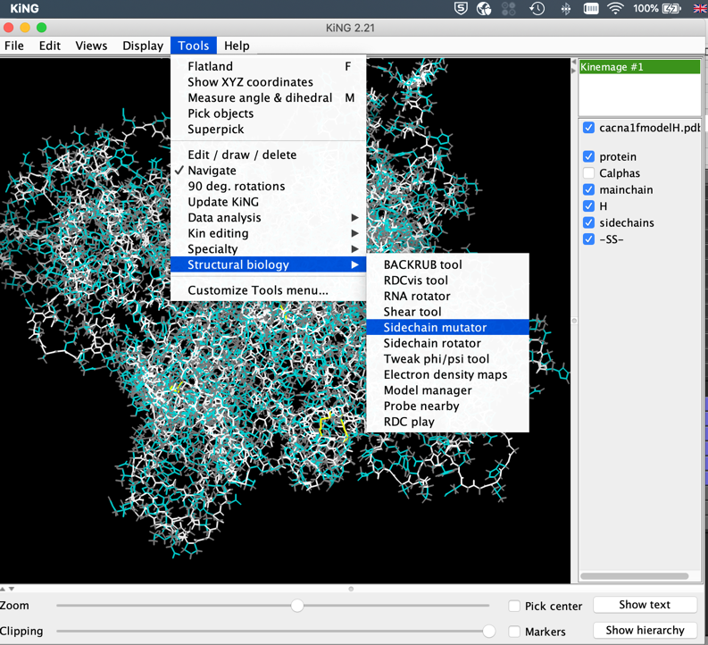
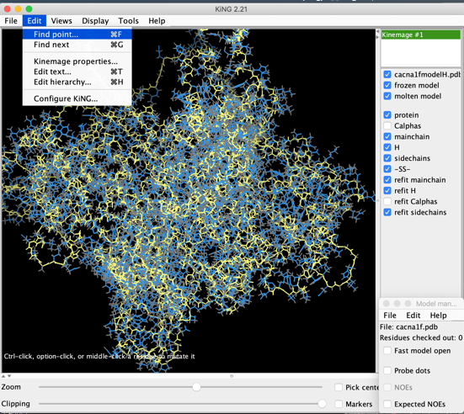
3) Protein Structure Analysis
Using KiNG
Notes:
Following choosing the option ‘sidechain mutator’, from the box that pops up choose the same pdb file with which you are working.
Find the amino acid you want to mutate, right/middle click on the alpha carbon (where the sidechain attaches to the backbone) and choose the amino acid you want to introduce

Slide 14
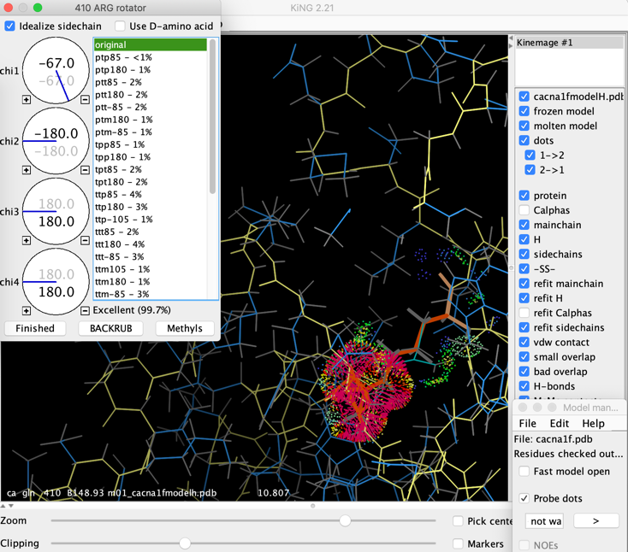
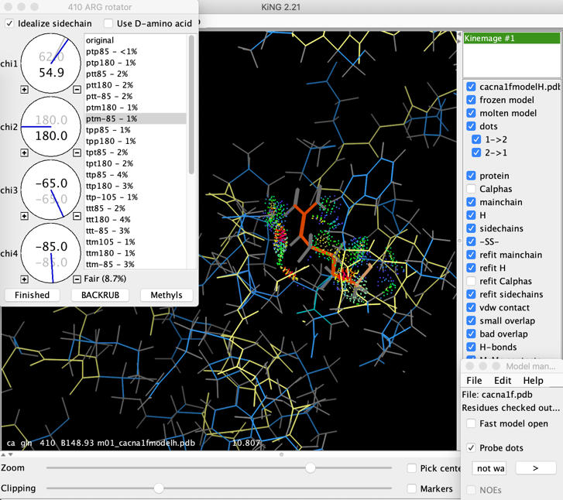
3) Protein Structure Analysis
Using KiNG
Notes:
Tick the “Probe dots” box in the bottom right of the window.
Play with the rotamers’ angles in the circles to adjust/fit the introduced residue, which might, if possible as in this demonstration, eliminate the red/pink spikes which correspond to clashes between the atoms of the different amino acids. However, keep an eye on the “Excellent” state of the rotamers as the angles with which they can rotate are limited (showing “Poor” if you have gone too far). The mutation in this demonstration therefore, is unlikely to have a negative structural/functional effect on the protein in terms of the volume of the amino acid introduced. Other factors such as any charge in charge, hydrophobicity as well as where the change is in the protein and if its involved in interaction need to be added to the overall analysis/decision making.

Slide 15
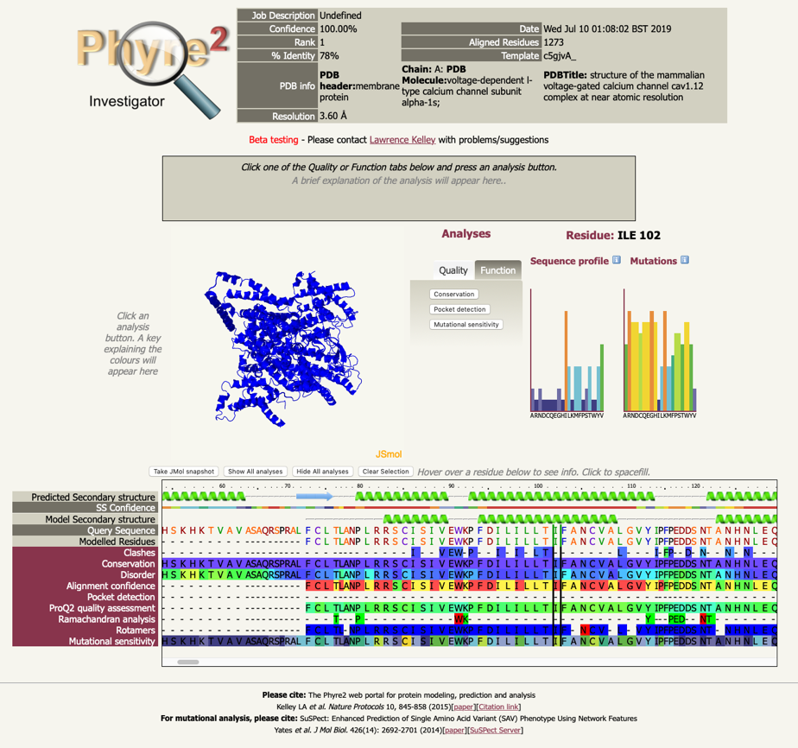
Integrated tools are available
Provide the protein sequence and tolls like Phyre2 provide structure/model & other info on the sequence

Slide 16
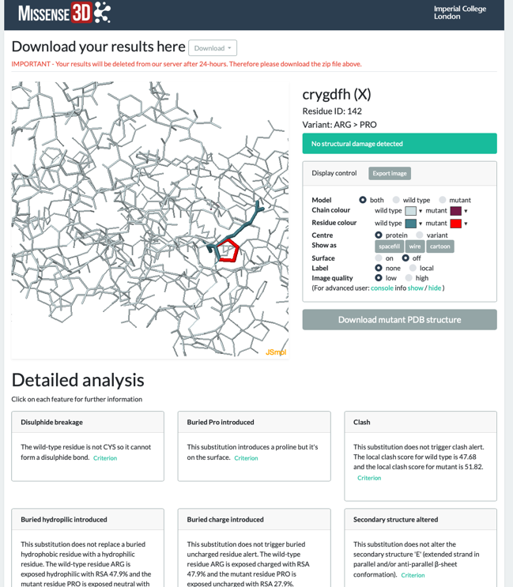
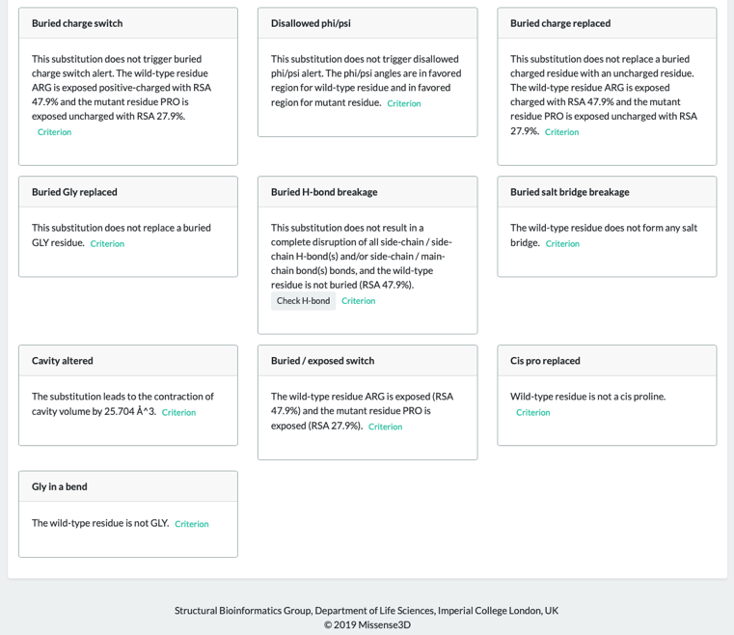
Integrated tools

Slide 17
What we have covered today:
An overview of protein structure
How to obtain protein structure/model
How mutation can affect protein structure
How to analyze mutations using protein structure
Find attached the links to prediction sites I didn’t have the time to cover.

Slide 18
Many many sites, databases & tools
https://www.uniprot.org (protein sequence/other info)
https://www.ebi.ac.uk/interpro/beta/ (protein sequence search & general info)
https://www.rcsb.org (protein structure & tutorials)
https://swissmodel.expasy.org (modelling)
http://www.russelllab.org/aas/ (amino acid properties, change & predictions)
https://pymol.org/2/ (PyMol)
https://pymolwiki.org/index.php/Main_Page (PyMol tutorials)
http://kinemage.biochem.duke.edu/software/king.php (KiNG & tutorials)
http://phyrerisk.bc.ic.ac.uk (integrated tool/analysis)
http://www.sbg.bio.ic.ac.uk/~missense3d/ (integrated tool predicts structural effect of mutations)
http://bipspi.cnb.csic.es/xgbPredApp/ (protein-protein interaction site prediction)
http://biosig.unimelb.edu.au/mcsm/stability (predicting mutation effect on protein stability)
http://foldxsuite.crg.eu/products#foldx (predicting mutation effect on protein stability)

Slide 19
Thank You!
We would like to say a big thank you to the Division of Evolution and Genomic Science for supporting this series, and all of you for attending!
Please join us for drinks and chat in the café!
And follow us on twitter - @EGS_UoM

